Slide 1
Application of Data Analytics to Prediction of Initial Production in Tight Oil Reservoir
Nathan Tran Master Thesis Update
August 24th 2018
Chair of the Committee
Dr. Ganesh Thakur
Distinguished Professor Of Petroleum Engineering and Director of UH Energy Industrial Partnerships
Committee members
Dr. Adwait Chawathe
Unit Manager
Chevron Corporation
Dr. Guan Qin
Professor
Department of Petroleum Engineering
Notes:
First of all thank you very much for being here with me today. I am going to present my thesis which is the…

Slide 2
Acknowledgements
Dr. Ganesh Thakur ( Thesis Advisor and Chair)
Dr. Adwait Chawathe (Thesis committee member)
Dr. Guan Qin (Thesis committee member)
Dr. Sushanta Bose
Dr. Rahul Kumar
Dr. Sriram Balasubramanian
Notes:
This work wouldn’t be completed without your support and guidance. A special thank to my adviser, dr. Thakur for your warm and kind advice. I appreciate your acceptance to be my committee members, Dr. Chawathe and Dr. Qin. I also want to acknowledge the post docs in EIP for their tremendous helps during the progress of my thesis.

Slide 3
Summary
Discussion Topics
Thesis description
Methodology and workflow
Predictive model
Blind test
Key Messages
Principal component analysis and linear regression can be used to develop a predictive model for IP.
In this case, components with the most correlation to IP contribute to a better prediction model than do the first components with greatest variance.
Thorough analysis and quality check on data are important before incorporating them into predictive model.
The model can be used to predict future wells’ initial production in reservoir LT.
Missing data should be handled with understanding the behavior of the parameters (Example, handling missing pressure data versus skin data)
The more data samples in the training set, the more robust the prediction model.
Desired Outcomes
Highlighting the feasibility of data analytics in predicting oil production performance
Feedbacks from committee members
Notes:
The topics I will cover today include…The key messages I would like to convey are the following…

Slide 4
Thesis Description
This thesis is the application of data analytical techniques namely principal component analysis and linear regression to predict initial production (IP) in a tight oil reservoir.
The reservoir model and field measurements (pressure transient test, PVT, completion, production, etc.) have been provided by the operator.
Data has been quality checked and analyzed to construct a data sheet. Then algorithms are carried out to develop a predictive model.
The model accuracy is about 76% for the set of data sample.
3 wells without being included in the model development has used for a blind test to confirm the reliability of the prediction.
Notes:
A quick description of my thesis…

Slide 5
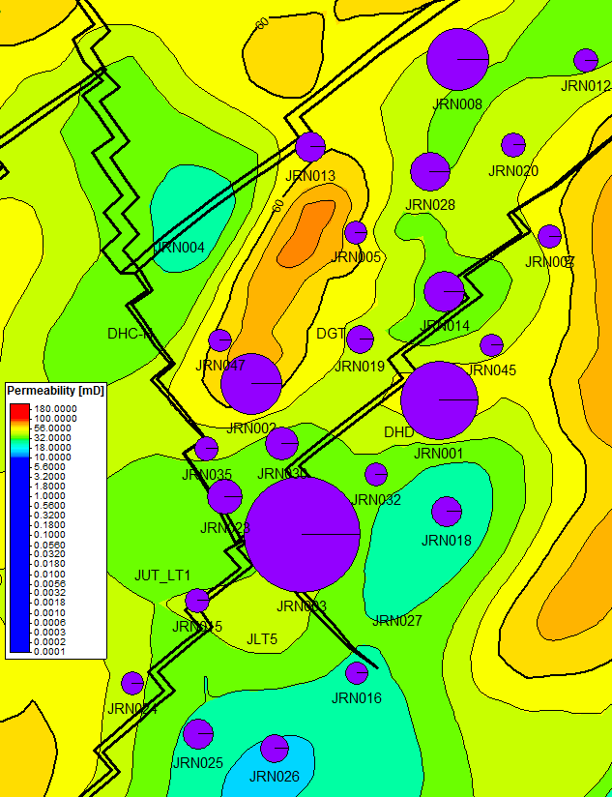
Field J Production on Structure Map and Permeability Map
Reservoir Property
Top of the reservoir (ft) | 9219
Gross thickness of the formation (ft) | 262
Original OWC (ft) | 10,007
Original GOC (ft) | 9449
Permeability (mD) Well tests (JRN008, JRN024, JRN001, JRN002, JRN003) Petrel map | 1.1 – 20 20 – 80
Porosity (fraction) | 0.12 – 0.15
Oil viscosity (cP) | 0.23 – 0.25
Bo (oil formation volume factor) (RB/STB) | 1.69 – 1.75
Reservoir Data
Initial GOR (scf/stb) | 1068
Current GOR (scf/stb) | 3147
Current water-cut (%) | 11
First production | May 1972
Initial reservoir pressure (psi) | 4500
Current reservoir pressure (psi) (most recent data) | 2500
Water injection period | 1984 – 2018
Cum. Oil Production on Permeability Map
High production rate wells tend to be located close to the faults.
Small producers close to the faults might be interfered by the great producers.
Some good to moderate permeable locations yields good productions.
Some wells are in good permeability area but production is low (J5, J47). The production may be affected strongly by other parameters (operations or other reservoir properties which haven’t been considered).
Notes:
Before I jump into my data modeling, I would like to provide some background about the fields from which I collect my data.
(Kh), (phi So h) maps may help to investigate more but here we are limited to only the available information for interpretation.

Slide 6
Field J Production (LT Reservoir)
Some infill wells help provide incremental production while some others contribute very little to field performance.
Evaluating the performance of new wells before drilling them will be a valuable information.

Slide 7
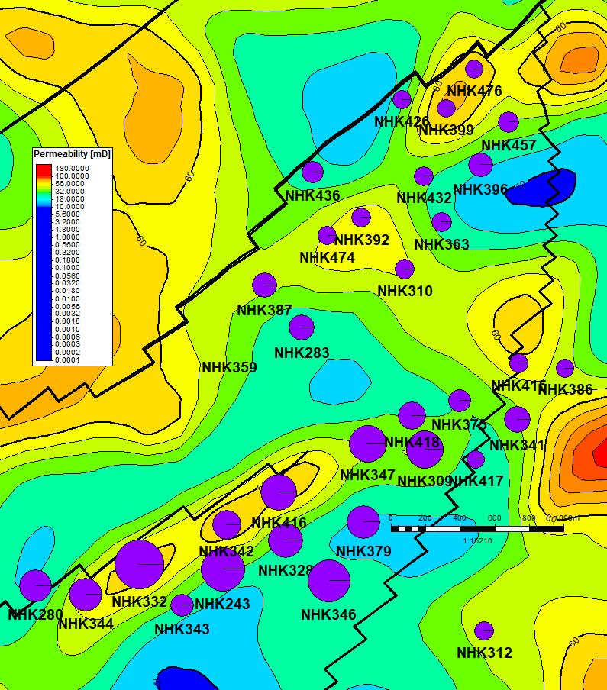
Field K Reservoir Properties and Production
Reservoir Property (LT)
Top of the reservoir (ft) | 8268
Gross thickness of formation (ft) (from log data in Petrel project) | 481
Original OWC (ft) | 8432
Original GOC (ft) | 8366
Permeability (mD) Permeability to oil, measured during well test on NHK243 and NHK379 Petrel project | 6.4 – 8.7 40 – 80
Effective Porosity (fraction) | 0.14 – 0.19
Oil viscosity (cP) | 0.5 – 0.6
Bo (oil formation volume factor) | 1.3 – 1.4
Bubble point pressure² @ BHT (psi) | 3130 – 3775
Reservoir Data
Initial GOR (scum/kl) (estimated from production data) | 562
Current GOR (scum/kl) (estimated from production data) | 3933
Current water-cut (%) | 93
First production | November 1970
Bottomhole temperature (degree C) | 75 – 80
Initial reservoir pressure (psi) | 3900
Cum. Oil on Permeability Map
Good producers are located in the southern region of the reservoir.
The good producers tend to be close to the fault in the southwest region.

Slide 8
Field K Production (LT Reservoir)
Some infill well help provide incremental production while some others contribute very little to field performance.
Evaluating the performance of new wells before drilling them will be a valuable information.
Notes:
Both fields are operated in conventional approach (vertical wells) whereas the reservoir properties indicate it is very close to unconventional reservoir type.

Slide 9
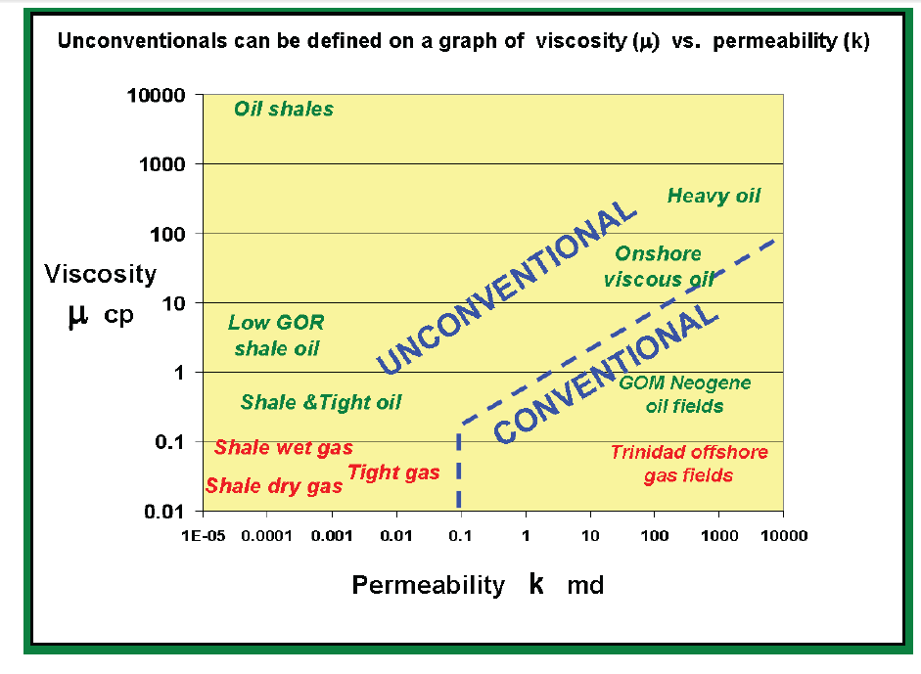
Proof of Tight Oil
Average reservoir properties of LT can be placed at the boundary between unconventional and conventional play characteristics. It can be a subject to be treated with unconventional field development technologies, such as, horizontal drilling and multi-stage fracking.
Definition of unconventional hydrocarbon resource (Cander, 2012)

Slide 10
Motivation to Predict IP
Infill drilling has been a strategy to provide incremental production in LT reservoir. Some infill wells have good performance while some others do not. Evaluating the performance of new wells before drilling them will be a valuable information.
Well performance is strongly affected by different properties in the reservoir. There is a need to incorporate all these possibly correlated properties into a model to evaluate wells’ performance.
Initial production: a stabilized rate during the first six month of oil production
IP rate is important because it is used for decline curve analysis to forecast cumulative production. The instantaneous rates and cumulative production are major parameters in economical analysis to assist decision making.
It is desired to develop a quick tool to predict IP for future infill wells.

Slide 11
Methodology
Goal: quick tool to predict IP for future infill wells.
Linear regression is a great candidate because it is very fast and the resulted model can be easy to understand. In addition, it is less prone to overfitting.
However, linear regression cannot model complex relationships. Also, it cannot capture nonlinear relationships.
Solution: describe in detail all the parameters possibly affecting the IP. Principal component analysis (PCA) will be used to transform the input to handle the nonlinear relationship and collinearity.

Slide 12
Work Flow
Define target function (IP)
Identify all key parameters dictating IP
Collect and process data relevant to the key parameters
Data transformation (PCA)
Linear regression to develop prediction model
Blind test
Finalize the model

Slide 13
Major Factors Dictating IP
Rock and Fluid
Characteristics
Reservoir Structure
IP
Reservoir Pressure and Drive Mechanism
Drilling and Completion Method
Well’s Characteristics or Well Type

Slide 14
Data Collection
Initial production: a stabilized rate during the first six month of oil production
Inputs from field measurements (extracted from database provided by operator):
Reservoir top depth, bottom depth, gross thickness
Total length of perforations
Fluid viscosity, FVF
Inputs from modeling:
Reservoir model (extracted from Petrel model): porosity, water saturations, permeability, Vsh, Vsh(cutoff)
SIBHP trends, FBHP (correlation)

Slide 15
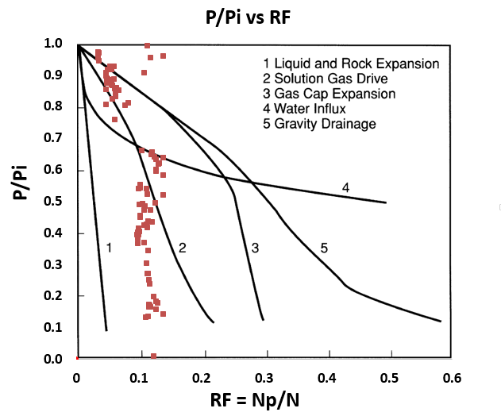
Handling SIBHP Missing Data by Using SIBHP Trend in Field J
Two major drive mechanisms are Solution Gas Drive (early time) and a combination of Solution Gas Drive and Liquid and Rock Expansion (later time)
The two SIBHP trends could be the responses from the two drive mechanisms in the reservoirs.

Slide 16
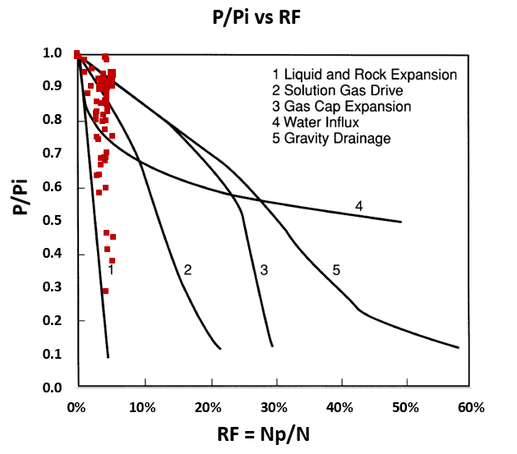
Handling SIBHP Missing Data by Using SIBHP Trend in Field K

Slide 17
Handling SIBHP Missing Data by Using SIBHP Trend Field N

Slide 18
Handling FBHP Missing Data by Using FBHP And SIBHP Correlation

Slide 19
Principal Component Analysis (PCA)
Given a data set of ‘n’ observations and ‘p’ variables, it can be written in form of matrix X_{nxp}.
Principal component analysis is a statistical technique that linearly transforms an original set of ‘p’ variables into a substantially smaller set of ‘k’ uncorrelated variables that represents most of the information in the original set of variables. Its goal is to reduce the dimensionality of the original data set.
If the p variables are correlated, they can be transformed into a relatively small set of k uncorrelated variables such that the ‘k’ derived variables will maximize the variance accounted for in the original variables. The ‘k’ variable are call principal components.

Slide 20
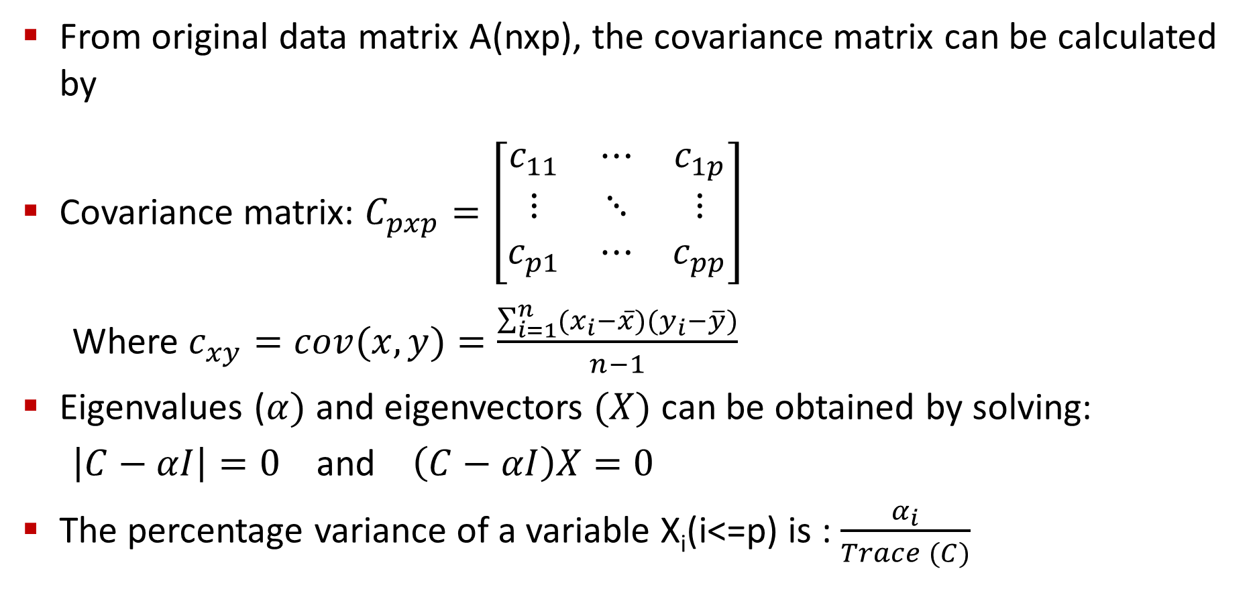
PCA Procedure
From original data matrix A(nxp), the covariance matrix can be calculated by
Covariance matrix: $C_{pxp}=\left[\begin{matrix}c_{11} & ⋯ & c_{1p} \\ ⋮ & ⋱ & ⋮ \\ c_{p1} & ⋯ & c_{pp}\end{matrix}\right]$
Where $c_{xy}=cov(x,y)=\frac{\sum_{i=1}^{n}{(x_{i}−\overline{x})(y_{i}−\overline{y})}}{n−1}$
Eigenvalues ($α)$ and eigenvectors $(X)$ can be obtained by solving:
$\left|C−αI\right|=0$ and $\left(C−αI\right)X=0$
The percentage variance of a variable X_{i}(i<=p) is : $\frac{α_{i}}{Trace (C)}$

Slide 21
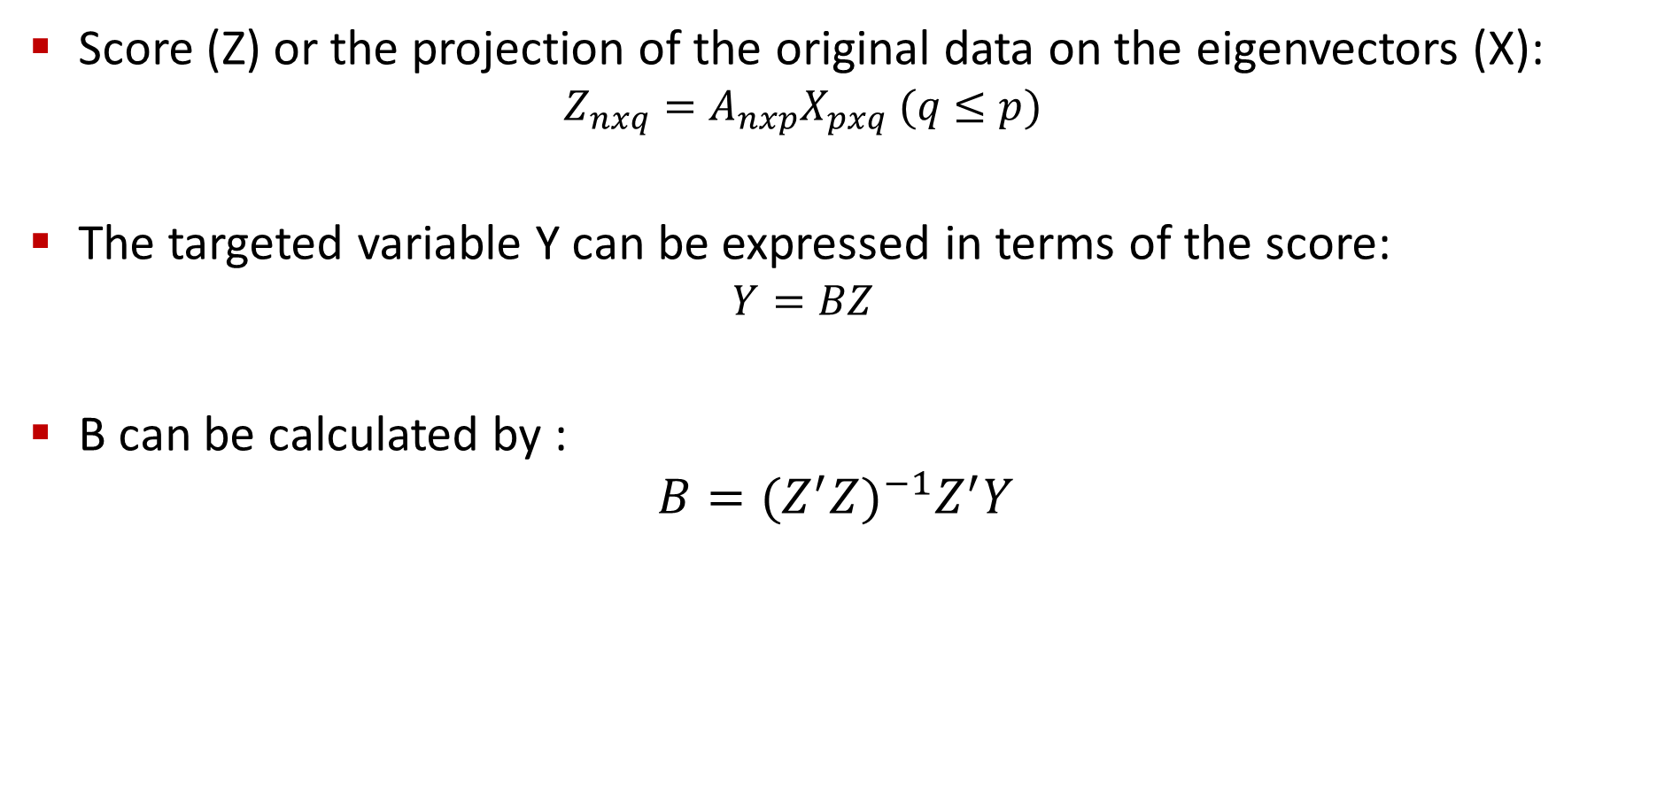
Linear Regression Using Principal Components
Score (Z) or the projection of the original data on the eigenvectors (X):
$$Z_{nxq}=A_{nxp}X_{pxq} (q≤p)$$
The targeted variable Y can be expressed in terms of the score:
$$Y=BZ$$
B can be calculated by :
$$B={(Z^{′}Z)}^{−1}Z^{′}Y$$

Slide 22
Data Transformation-PCA
Variable
Top of LT
Bottom of LT
Reservoir Gross Thickness
Total Perf.
SBHP
FBHP
Viscosity
Bo
VSH (Std_Dev)
VSH (Mean)
VSH (P50)
VSH (P10 )
VSH (P90 )
SWT (Std_Dev)
SWT (Mean)
SWT (P50)
SWT (P10 )
SWT (P90 )
SWI (Std_Dev)
SWI (Mean)
SWI (P50)
SWI (P10 )
SWI (P90 )
SWE (Std_Dev)
SWE (Mean)
SWE (P50)
SWE (P10 )
SWE (P90 )
PHIE (Std_Dev)
PHIE (Mean)
PHIE (P50)
PHIE (P10 )
PHIE (P90 )
Vsh Cuttoff
PERM (Std_Dev)
PERM (Mean)
PERM (P50)
PERM (P10 )
PERM (P90 )
Data sheet: 39 parameters, 30 well samples
PCA: 29 Components
 | F1 | F2 | F3 | F4 | F5 | F6 | F7 | F8 | F9 | F10
Eigenvalue | 12.747 | 8.894 | 6.908 | 3.324 | 1.425 | 1.307 | 1.090 | 0.873 | 0.626 | 0.528
Variability (%) | 32.684 | 22.804 | 17.714 | 8.522 | 3.655 | 3.351 | 2.795 | 2.239 | 1.606 | 1.354
Cumulative % | 32.684 | 55.488 | 73.202 | 81.724 | 85.378 | 88.729 | 91.525 | 93.764 | 95.369 | 96.723
 | F11 | F12 | F13 | F14 | F15 | F16 | F17 | F18 | F19 | F20
Eigenvalue | 0.391 | 0.245 | 0.156 | 0.145 | 0.081 | 0.067 | 0.057 | 0.039 | 0.027 | 0.022
Variability (%) | 1.002 | 0.629 | 0.401 | 0.372 | 0.208 | 0.171 | 0.147 | 0.099 | 0.069 | 0.057
Cumulative % | 97.726 | 98.355 | 98.756 | 99.128 | 99.336 | 99.508 | 99.655 | 99.753 | 99.822 | 99.879
 | F21 | F22 | F23 | F24 | F25 | F26 | F27 | F28 | F29
Eigenvalue | 0.019 | 0.012 | 0.007 | 0.004 | 0.002 | 0.002 | 0.001 | 0.001 | 0.000
Variability (%) | 0.048 | 0.030 | 0.017 | 0.009 | 0.006 | 0.005 | 0.003 | 0.002 | 0.001
Cumulative % | 99.926 | 99.956 | 99.973 | 99.983 | 99.989 | 99.994 | 99.997 | 99.999 | 100

Slide 23
Selecting the Components for Regression
Two methods of selecting the components to build regression are performed. The results will be compare to determine the better method.
Component | Initial Production
F1 | -0.205
F2 | -0.145
F3 | 0.146
F4 | 0.269
F5 | -0.006
F6 | 0.252
F7 | -0.005
F8 | -0.172
F9 | 0.305
F10 | -0.399
F11 | -0.065
F12 | 0.221
F13 | -0.058
F14 | -0.043
F15 | 0.099
F16 | -0.074
F17 | 0.250
F18 | 0.028
F19 | 0.217
F20 | -0.248
F21 | -0.056
F22 | 0.257
F23 | 0.085
F24 | 0.105
F25 | -0.099
F26 | -0.123
F27 | -0.126
F28 | -0.298
F29 | 0.188
10 Components mostly correlated to IP.
10 Components with highest variance
Completion Number | IP | F4 | F6 | F9 | F10 | F12 | F17 | F19 | F20 | F22 | F28
1E | 79.44214 | -0.144 | 2.489 | 1.360 | 0.540 | -0.480 | -0.190 | -0.077 | -0.005 | 0.044 | 0.001
2D | 322.1655 | 1.032 | 0.801 | 0.821 | -1.265 | -0.306 | -0.137 | -0.269 | -0.021 | -0.007 | 0.002
3 | 231.0263 | 4.429 | 0.748 | 0.109 | 0.141 | 0.475 | -0.234 | -0.100 | -0.048 | -0.067 | 0.002
8 | 836.8599 | 1.303 | 0.715 | 0.692 | -0.918 | 0.136 | 0.477 | 0.446 | -0.026 | 0.009 | -0.006
14 | -80.8849 | 1.309 | 1.409 | -0.011 | 0.989 | 0.669 | 0.203 | 0.114 | 0.136 | -0.081 | 0.008
18 | -52.8953 | -3.025 | 0.497 | 1.160 | -0.524 | 0.671 | 0.191 | -0.105 | 0.164 | 0.069 | 0.006
19 | 36.98599 | 1.475 | -1.929 | -0.855 | -0.642 | -0.345 | 0.018 | 0.075 | -0.023 | -0.003 | -0.028
20 | -200.957 | -1.532 | -2.180 | 0.960 | 0.295 | -0.260 | 0.078 | -0.110 | -0.044 | 0.059 | -0.011
25D | -120.636 | -4.814 | 0.861 | -0.052 | 0.715 | -0.013 | -0.364 | 0.016 | 0.000 | -0.116 | -0.007
26D | -103.465 | -2.107 | 0.117 | -0.454 | 0.815 | -1.259 | 0.098 | 0.154 | -0.122 | 0.183 | 0.022
28 | 190.0168 | 0.567 | -1.974 | -0.367 | -0.351 | 0.549 | -0.113 | -0.067 | -0.085 | 0.135 | 0.005
30 | -212.405 | -2.597 | -1.608 | 0.109 | -0.485 | 0.381 | -0.334 | -0.019 | 0.038 | -0.019 | 0.005
32D | -320.463 | -0.543 | -0.562 | -1.256 | -0.095 | -0.450 | 0.273 | 0.049 | 0.054 | -0.178 | 0.000
243 | 231.7811 | 1.252 | -0.327 | 1.353 | -0.239 | 0.481 | -0.114 | 0.088 | -0.038 | 0.032 | -0.027
283D | -138.94 | 2.435 | 0.899 | -1.499 | 0.903 | -0.120 | 0.080 | -0.236 | -0.008 | 0.182 | 0.006
309 | -150.765 | 0.491 | -0.246 | 0.004 | -0.456 | -1.266 | -0.054 | 0.046 | 0.138 | -0.072 | -0.034
310D | -313.419 | -1.044 | 0.017 | 0.131 | -0.730 | -0.384 | -0.267 | 0.115 | -0.069 | -0.070 | 0.043
341 | 237.8822 | -0.485 | 1.007 | 0.515 | -0.443 | 0.009 | 0.030 | -0.041 | 0.029 | 0.139 | -0.028
343A | -263.729 | -0.436 | 0.033 | -0.832 | -0.240 | 0.079 | 0.165 | -0.397 | 0.327 | -0.085 | -0.004
344 | 207.8799 | -0.664 | -0.580 | -0.226 | -0.227 | 0.339 | 0.299 | -0.034 | -0.191 | -0.032 | -0.011
347D | 32.77182 | -0.010 | 0.421 | -0.294 | -0.437 | -0.320 | 0.342 | -0.224 | -0.098 | 0.016 | 0.010
379 | 21.26149 | -2.239 | 0.249 | -0.405 | 0.441 | 0.954 | 0.320 | 0.105 | 0.013 | 0.009 | 0.000
387D | -73.2113 | 0.381 | 0.979 | -1.747 | -0.818 | 0.290 | -0.519 | 0.288 | 0.199 | 0.106 | -0.007
392D | -166.992 | -0.455 | -0.113 | -0.884 | -0.213 | 0.783 | -0.075 | 0.012 | -0.140 | 0.005 | 0.023
396D | -104.912 | 1.897 | -0.205 | 0.518 | 0.413 | -0.003 | -0.154 | 0.095 | -0.035 | -0.056 | -0.005
418 | -117.617 | -0.362 | 1.196 | -0.599 | 0.520 | 0.019 | -0.078 | -0.062 | -0.400 | -0.135 | -0.022
457D | -194.479 | 2.242 | -0.808 | 0.741 | -0.590 | -0.313 | 0.043 | 0.017 | 0.039 | -0.066 | 0.054
476D | -353.359 | 0.705 | -0.856 | 0.331 | 1.759 | -0.297 | 0.057 | 0.161 | 0.227 | -0.015 | 0.004
274 | -153.784 | 1.349 | -1.760 | 0.675 | 1.572 | 0.237 | -0.164 | -0.056 | -0.007 | 0.003 | -0.001
298E | -28.2392 | -0.411 | 0.712 | 0.001 | -0.427 | -0.259 | 0.122 | 0.018 | -0.002 | 0.010 | 0.001
Completion Number | IP | F1 | F2 | F3 | F4 | F5 | F6 | F7 | F8 | F9 | F10
1E | 79.44214 | -5.298 | 0.395 | 0.170 | -0.144 | -0.491 | 2.489 | -0.538 | -0.349 | 1.360 | 0.540
2D | 322.1655 | -2.443 | -1.145 | 5.844 | 1.032 | -1.771 | 0.801 | 1.203 | -0.954 | 0.821 | -1.265
3 | 231.0263 | -8.625 | -0.776 | -2.464 | 4.429 | 1.559 | 0.748 | -1.238 | -0.724 | 0.109 | 0.141
8 | 836.8599 | -1.955 | -2.655 | 3.514 | 1.303 | -0.758 | 0.715 | 0.210 | -0.472 | 0.692 | -0.918
14 | -80.8849 | -2.294 | -3.034 | -3.087 | 1.309 | -0.624 | 1.409 | -0.587 | 1.608 | -0.011 | 0.989
18 | -52.8953 | -0.162 | -2.645 | -0.275 | -3.025 | 0.311 | 0.497 | 0.525 | -0.180 | 1.160 | -0.524
19 | 36.98599 | -3.204 | -1.452 | -1.599 | 1.475 | 1.276 | -1.929 | -0.434 | -1.295 | -0.855 | -0.642
20 | -200.957 | -3.380 | 1.548 | -2.102 | -1.532 | -0.436 | -2.180 | -0.034 | 0.103 | 0.960 | 0.295
25D | -120.636 | -1.309 | -2.012 | -0.957 | -4.814 | 0.899 | 0.861 | 0.773 | -1.152 | -0.052 | 0.715
26D | -103.465 | -1.224 | -4.210 | -1.640 | -2.107 | 1.105 | 0.117 | -0.127 | -0.723 | -0.454 | 0.815
28 | 190.0168 | -3.872 | -2.128 | -0.912 | 0.567 | -0.532 | -1.974 | 1.176 | 0.395 | -0.367 | -0.351
30 | -212.405 | -2.613 | -2.348 | -0.733 | -2.597 | -1.400 | -1.608 | -0.928 | 2.372 | 0.109 | -0.485
32D | -320.463 | -2.597 | -4.937 | 1.107 | -0.543 | -0.594 | -0.562 | 1.753 | 0.352 | -1.256 | -0.095
243 | 231.7811 | 6.017 | -0.199 | -4.263 | 1.252 | 0.857 | -0.327 | 1.107 | -0.104 | 1.353 | -0.239
283D | -138.94 | 3.595 | -1.793 | -0.326 | 2.435 | -0.618 | 0.899 | 0.381 | 0.255 | -1.499 | 0.903
309 | -150.765 | 1.516 | 1.655 | 0.030 | 0.491 | -0.521 | -0.246 | -2.304 | 0.647 | 0.004 | -0.456
310D | -313.419 | 4.985 | 2.214 | 0.219 | -1.044 | -0.138 | 0.017 | -0.867 | -0.497 | 0.131 | -0.730
341 | 237.8822 | 3.604 | 1.233 | -1.931 | -0.485 | -0.306 | 1.007 | -0.519 | 0.260 | 0.515 | -0.443
343A | -263.729 | 3.353 | -0.017 | -0.823 | -0.436 | 0.984 | 0.033 | 0.165 | -1.140 | -0.832 | -0.240
344 | 207.8799 | -0.350 | 4.910 | -0.522 | -0.664 | -0.244 | -0.580 | -0.497 | -0.967 | -0.226 | -0.227
347D | 32.77182 | 1.433 | 1.602 | 0.190 | -0.010 | -1.200 | 0.421 | -0.789 | 1.246 | -0.294 | -0.437
379 | 21.26149 | 2.438 | 0.157 | 1.682 | -2.239 | 0.529 | 0.249 | -2.222 | -0.817 | -0.405 | 0.441
387D | -73.2113 | 0.827 | 1.495 | 1.483 | 0.381 | -0.370 | 0.979 | -0.063 | 0.180 | -1.747 | -0.818
392D | -166.992 | -1.022 | 5.325 | 0.808 | -0.455 | -0.594 | -0.113 | 0.313 | -0.845 | -0.884 | -0.213
396D | -104.912 | 8.209 | -2.745 | -0.454 | 1.897 | -0.342 | -0.205 | 1.849 | -0.191 | 0.518 | 0.413
418 | -117.617 | 2.495 | 0.227 | -0.802 | -0.362 | -0.668 | 1.196 | 0.255 | 0.808 | -0.599 | 0.520
457D | -194.479 | 3.342 | -0.181 | -3.634 | 2.242 | 0.736 | -0.808 | -0.551 | 0.066 | 0.741 | -0.590
476D | -353.359 | -2.470 | 8.028 | -0.505 | 0.705 | -2.029 | -0.856 | 1.479 | -0.423 | 0.331 | 1.759
274 | -153.784 | 3.142 | -2.189 | 9.149 | 1.349 | 1.221 | -1.760 | -1.287 | 0.271 | 0.675 | 1.572
298E | -28.2392 | -2.139 | 5.677 | 2.833 | -0.411 | 4.160 | 0.712 | 1.797 | 2.272 | 0.001 | -0.427

Slide 24


Linear Regression with 10 Components Most Correlated to IP
$$F_{i}= β_{i}X_{i}$$
 | F1 | F4 | F9 | F10 | F12 | F14 | F17 | F20 | F29 | F31
Top of LT | -0.188 | -0.125 | 0.334 | 0.125 | -0.186 | -0.319 | -0.188 | 0.043 | 0.075 | -0.023
Bottom of LT | -0.193 | -0.137 | 0.310 | 0.085 | -0.140 | -0.277 | -0.153 | 0.050 | 0.073 | -0.022
Reservoir Gross Thickness | -0.173 | -0.203 | 0.002 | -0.305 | 0.321 | 0.186 | 0.211 | 0.093 | 0.026 | 0.001
Total Perf. | -0.057 | -0.120 | 0.403 | 0.013 | 0.414 | 0.108 | -0.016 | -0.058 | -0.017 | -0.015
SBHP | 0.068 | 0.310 | 0.328 | -0.038 | 0.158 | -0.035 | -0.039 | -0.001 | -0.020 | -0.010
FBHP | 0.068 | 0.310 | 0.328 | -0.038 | 0.158 | -0.035 | -0.039 | -0.001 | -0.020 | -0.010
Viscosity | 0.073 | 0.050 | -0.010 | 0.444 | 0.082 | -0.086 | 0.246 | 0.060 | -0.048 | -0.118
Bo | -0.197 | -0.095 | 0.311 | -0.124 | -0.136 | -0.130 | 0.323 | 0.114 | -0.126 | 0.020
VSH (Std_Dev) | -0.007 | 0.052 | 0.043 | -0.109 | -0.001 | -0.017 | -0.050 | -0.099 | -0.317 | 0.043
VSH (Mean) | 0.236 | 0.147 | 0.141 | -0.092 | -0.039 | -0.048 | 0.269 | -0.165 | 0.054 | -0.035
VSH (P50) | 0.250 | 0.135 | 0.034 | -0.157 | -0.019 | -0.121 | 0.186 | 0.003 | 0.125 | -0.150
VSH (P10 ) | 0.214 | 0.083 | 0.197 | 0.046 | -0.051 | 0.106 | 0.066 | -0.148 | -0.020 | 0.314
VSH (P90 ) | 0.135 | 0.134 | 0.159 | -0.102 | -0.110 | 0.162 | 0.002 | -0.012 | 0.226 | -0.218
SWT (Std_Dev) | -0.179 | -0.007 | -0.067 | 0.071 | 0.020 | -0.127 | -0.121 | -0.147 | 0.225 | 0.267
SWT (Mean) | 0.224 | -0.233 | 0.043 | 0.085 | 0.114 | -0.124 | 0.036 | -0.178 | 0.106 | -0.188
SWT (P50) | 0.223 | -0.213 | 0.063 | 0.114 | 0.194 | -0.297 | 0.116 | 0.306 | 0.069 | -0.048
SWT (P10 ) | 0.226 | -0.156 | 0.029 | -0.002 | 0.028 | 0.057 | 0.078 | -0.155 | 0.112 | 0.298
SWT (P90 ) | 0.143 | -0.294 | -0.016 | 0.062 | -0.102 | 0.129 | -0.067 | 0.110 | -0.071 | 0.013
SWI (Std_Dev) | -0.007 | 0.027 | 0.060 | -0.019 | 0.050 | 0.099 | -0.368 | -0.060 | -0.026 | -0.089
SWI (Mean) | 0.248 | 0.150 | 0.033 | 0.077 | 0.046 | 0.004 | -0.040 | 0.101 | 0.107 | 0.437
SWI (P50) | 0.257 | 0.145 | -0.060 | -0.057 | 0.031 | -0.126 | -0.022 | 0.285 | -0.049 | -0.025
SWI (P10 ) | 0.231 | 0.094 | 0.068 | 0.106 | -0.053 | 0.061 | -0.013 | 0.094 | -0.088 | -0.378
SWI (P90 ) | 0.117 | 0.125 | 0.116 | 0.083 | -0.054 | 0.135 | -0.141 | 0.107 | -0.151 | 0.107
SWE (Std_Dev) | -0.121 | 0.035 | -0.189 | 0.215 | 0.225 | -0.243 | 0.099 | -0.201 | -0.013 | -0.200
SWE (Mean) | 0.171 | -0.272 | 0.097 | -0.002 | 0.002 | -0.062 | -0.147 | -0.283 | 0.012 | -0.125
SWE (P50) | 0.173 | -0.256 | 0.099 | 0.026 | 0.060 | -0.224 | -0.008 | 0.165 | -0.259 | 0.227
SWE (P10 ) | 0.161 | -0.217 | 0.125 | -0.151 | -0.141 | 0.186 | -0.151 | -0.214 | 0.090 | -0.155
SWE (P90 ) | 0.129 | -0.303 | -0.016 | 0.075 | -0.041 | 0.082 | 0.012 | 0.041 | -0.013 | 0.027
PHIE (Std_Dev) | 0.021 | -0.044 | -0.134 | 0.021 | -0.222 | 0.028 | 0.175 | 0.356 | 0.218 | 0.020
PHIE (Mean) | -0.054 | 0.097 | 0.027 | -0.086 | -0.180 | -0.197 | -0.109 | -0.058 | 0.307 | 0.242
PHIE (P50) | -0.069 | 0.082 | 0.030 | -0.146 | -0.343 | -0.109 | -0.057 | -0.005 | -0.388 | -0.147
PHIE (P10 ) | -0.045 | 0.092 | -0.005 | -0.080 | 0.221 | -0.129 | -0.208 | 0.342 | 0.127 | -0.087
PHIE (P90 ) | -0.027 | 0.082 | -0.039 | -0.046 | -0.145 | -0.311 | 0.145 | -0.163 | 0.026 | -0.012
Vsh Cuttoff | 0.147 | 0.188 | -0.199 | 0.222 | 0.002 | -0.129 | -0.200 | -0.104 | -0.038 | -0.033
PERM (Std_Dev) | -0.110 | 0.031 | -0.104 | -0.264 | 0.289 | -0.049 | -0.201 | 0.147 | -0.062 | 0.016
PERM (Mean) | -0.166 | 0.051 | 0.096 | 0.094 | 0.010 | 0.124 | 0.085 | 0.000 | 0.488 | -0.158
PERM (P50) | -0.178 | 0.032 | 0.200 | 0.293 | -0.205 | 0.359 | 0.132 | 0.221 | -0.061 | 0.020
PERM (P10 ) | -0.146 | 0.054 | 0.028 | 0.468 | 0.167 | 0.127 | -0.041 | -0.115 | -0.121 | 0.063
PERM (P90 ) | -0.139 | 0.071 | -0.002 | -0.089 | 0.083 | -0.088 | 0.381 | -0.217 | -0.151 | 0.096
$$IP= α_{i}F_{i}$$
Model Parameters
Intercept | 359.649
F1 | -16.240
F4 | 46.001
F9 | 71.006
F10 | -102.000
F12 | 105.700
F14 | -157.706
F17 | -414.986
F20 | -379.715
F29 | -3925.685
F31 | 10082.908

Slide 25
Evaluating Model with 10 Components Mostly Correlated to IP
Observation | Weight | Initial Production | Pred(Initial Production) | Residual | Std. residual
JRN001E | 1 | 79.442 | 65.910 | 13.532 | 0.092
JRN002D | 1 | 322.166 | 141.402 | 180.764 | 1.235
JRN003 | 1 | 231.026 | 85.466 | 145.560 | 0.994
JRN008 | 1 | 836.860 | 571.161 | 265.698 | 1.815
JRN014 | 1 | -80.885 | -23.308 | -57.576 | -0.393
JRN018 | 1 | -52.895 | 110.591 | -163.486 | -1.117
JRN019 | 1 | 36.986 | 36.685 | 0.301 | 0.002
JRN020 | 1 | -200.957 | -85.166 | -115.791 | -0.791
JRN025D | 1 | -120.636 | -393.632 | 272.996 | 1.865
JRN026D | 1 | -103.465 | -196.603 | 93.138 | 0.636
JRN028 | 1 | 190.017 | 19.394 | 170.623 | 1.165
JRN030 | 1 | -212.405 | -234.131 | 21.727 | 0.148
JRN032D | 1 | -320.463 | -287.153 | -33.310 | -0.228
NHK243 | 1 | 231.781 | 349.329 | -117.548 | -0.803
NHK283D | 1 | -138.940 | -102.958 | -35.982 | -0.246
NHK309 | 1 | -150.765 | -70.202 | -80.562 | -0.550
NHK310D | 1 | -313.419 | -205.968 | -107.451 | -0.734
NHK341 | 1 | 237.882 | 307.461 | -69.579 | -0.475
NHK343A | 1 | -263.729 | -347.338 | 83.609 | 0.571
NHK344 | 1 | 207.880 | 137.473 | 70.407 | 0.481
NHK347D | 1 | 32.772 | 32.119 | 0.653 | 0.004
NHK379 | 1 | 21.261 | 30.283 | -9.021 | -0.062
NHK387D | 1 | -73.211 | -10.884 | -62.327 | -0.426
NHK392D | 1 | -166.992 | -57.469 | -109.524 | -0.748
NHK396D | 1 | -104.912 | 8.886 | -113.798 | -0.777
NHK418 | 1 | -117.617 | 35.544 | -153.162 | -1.046
NHK457D | 1 | -194.479 | -128.311 | -66.167 | -0.452
NHK476D | 1 | -353.359 | -337.141 | -16.218 | -0.111
NHK274 | 1 | -153.784 | -245.771 | 91.987 | 0.628
NHK298E | 1 | -28.239 | 71.255 | -99.494 | -0.680
Model Parameters
Intercept | -24.103
F4 | 35.458
F6 | 54.812
F9 | 92.119
F10 | -132.184
F12 | 102.135
F17 | 263.632
F19 | 320.213
F20 | -446.216
F22 | 704.626
F28 | -3822.572
R² =0.76
Blind test:
Well 23, 280 are predicted within the tolerance range of the predictive model
Well 328 is outside of the tolerance range of the prediction model. It is consider to be an outliner or there might be error in the data of this well.

Slide 26
Evaluating Model with First 10 Components
Observation | Weight | Initial Production | Pred(Initial Production) | Residual | Std. residual
JRN001E | 1 | 79.442 | 247.758 | -168.316 | -0.794
JRN002D | 1 | 322.166 | 466.137 | -143.971 | -0.679
JRN003 | 1 | 231.026 | 291.269 | -60.243 | -0.284
JRN008 | 1 | 836.860 | 372.109 | 464.751 | 2.191
JRN014 | 1 | -80.885 | -75.899 | -4.986 | -0.024
JRN018 | 1 | -52.895 | 108.458 | -161.353 | -0.761
JRN019 | 1 | 36.986 | 24.381 | 12.605 | 0.059
JRN020 | 1 | -200.957 | -152.173 | -48.785 | -0.230
JRN025D | 1 | -120.636 | -169.051 | 48.415 | 0.228
JRN026D | 1 | -103.465 | -166.967 | 63.501 | 0.299
JRN028 | 1 | 190.017 | -51.902 | 241.919 | 1.141
JRN030 | 1 | -212.405 | -178.823 | -33.582 | -0.158
JRN032D | 1 | -320.463 | -86.233 | -234.230 | -1.104
NHK243 | 1 | 231.781 | 24.787 | 206.994 | 0.976
NHK283D | 1 | -138.940 | -189.389 | 50.450 | 0.238
NHK309 | 1 | -150.765 | -24.799 | -125.966 | -0.594
NHK310D | 1 | -313.419 | -19.687 | -293.732 | -1.385
NHK341 | 1 | 237.882 | 20.145 | 217.737 | 1.027
NHK343A | 1 | -263.729 | -90.108 | -173.622 | -0.819
NHK344 | 1 | 207.880 | -86.171 | 294.050 | 1.386
NHK347D | 1 | 32.772 | -59.328 | 92.099 | 0.434
NHK379 | 1 | 21.261 | -160.540 | 181.802 | 0.857
NHK387D | 1 | -73.211 | -26.324 | -46.888 | -0.221
NHK392D | 1 | -166.992 | -99.490 | -67.502 | -0.318
NHK396D | 1 | -104.912 | -54.293 | -50.619 | -0.239
NHK418 | 1 | -117.617 | -177.871 | 60.254 | 0.284
NHK457D | 1 | -194.479 | 62.536 | -257.015 | -1.212
NHK476D | 1 | -353.359 | -295.282 | -58.077 | -0.274
NHK274 | 1 | -153.784 | -126.729 | -27.055 | -0.128
NHK298E | 1 | -28.239 | -49.601 | 21.362 | 0.101
Model Parameters
Intercept | -24.103
F1 | -13.673
F2 | -11.677
F3 | 13.226
F4 | 35.458
F5 | -1.123
F6 | 54.812
F7 | -1.049
F8 | -44.159
F9 | 92.119
F10 | -132.184
Well 328
Well 23
R²=0.50
Well 280
Blind test:
Well 23 and 280 are predicted within the tolerance range of the prediction model
Well 328 is outside of the tolerance range of the prediction model. It is consider to be an outliner or there might be error in the data of this well.

Slide 27
Correcting Data for Well N328
CompletionNumber | NHK328
Top of LT | 9091.207
Bottom of LT | 9620.737
Reservoir Gross Thickness | 529.530
Total Perf. | 19.685
SBHP | 3819.800
FBHP | 2265.212
Viscosity | 0.570
Bo | 1.316
VSH (Std_Dev) | 0.086
VSH (Mean) | 0.159
VSH (P50) | 0.155
VSH (P10 ) | 0.051
VSH (P90 ) | 0.252
SWT (Std_Dev) | 0.109
SWT (Mean) | 0.723
SWT (P50) | 0.693
SWT (P10 ) | 0.608
SWT (P90 ) | 0.887
SWI (Std_Dev) | 0.047
SWI (Mean) | 0.413
SWI (P50) | 0.409
SWI (P10 ) | 0.354
SWI (P90 ) | 0.465
SWE (Std_Dev) | 0.134
SWE (Mean) | 0.675
SWE (P50) | 0.658
SWE (P10 ) | 0.514
SWE (P90 ) | 0.874
PHIE (Std_Dev) | 0.029
PHIE (Mean) | 0.198
PHIE (P50) | 0.200
PHIE (P10 ) | 0.158
PHIE (P90 ) | 0.233
Vsh Cuttoff | 0.290
PERM (Std_Dev) | 80.885
PERM (Mean) | 98.630
PERM (P50) | 72.632
PERM (P10 ) | 21.718
PERM (P90 ) | 223.889
Changing the data values doesn’t help model, built by first 10 components, to bring prediction into the tolerance range.
The model, built by 10 correlated components, is most sensitive to the parameter SWT(P50). Changing it from 0.69 to 0.63 will make the prediction in the tolerance range. Further confirmation from operator is needed to confirm the change.
Well 328
0.630

Slide 28
Average versus Probabilistic Properties
Prediction with Averaged Properties
R² = 0.39, Wide Tolerance range
Prediction with Std.Dev, Mean, P10, P50 and P90 of The Properties, R² = 0.76, Narrower Tolerance Range

Slide 29
Adding New Parameter-Skin
Completion Number | Skin
JRN001E | 5.1500
JRN002D | 2.6000
JRN003 | 25.1000
JRN008 | 8.5000
JRN014 | 15.7000
JRN018 | 11.0833
JRN019 | 11.0833
JRN020 | 11.0833
JRN025D | 11.0833
JRN026D | 11.0833
JRN028 | 11.0833
JRN030 | 11.0833
JRN032D | 9.4500
NHK243 | 6.3400
NHK283D | 2.1500
NHK309 | 2.1500
NHK310D | 2.1500
NHK341 | 2.1500
NHK343A | 2.1500
NHK344 | 2.1500
NHK347D | 2.1500
NHK379 | -2.0400
NHK387D | 2.1500
NHK392D | 2.1500
NHK396D | 2.1500
NHK418 | 2.1500
NHK457D | 2.1500
NHK476D | 2.1500
NHK274 | 8.8500
NHK298E | 8.8500
Skin values are from well test reports of 8 wells. The other values are estimated by averaging the skin of other wells in the reservoir.
R2 value of the prediction model is reduced from 76% to 66%.
Average Values
R²=0.76
R²=0.66

Slide 30
Robustness Test
Training data set (25)
Testing data set (8)
Completion Number
JRN001E
JRN003
JRN008
JRN014
JRN018
JRN019
JRN020
JRN025D
JRN026D
JRN030
JRN032D
NHK243
NHK283D
NHK309
NHK341
NHK343A
NHK344
NHK347D
NHK379
NHK387D
NHK392D
NHK396D
NHK457D
NHK476D
NHK298E
Completion Number
JRN023D
JRN002D
JRN028
NHK310D
NHK328
NHK274
NHK280
NHK418
The model couldn’t predict IP for the training set. Therefore, the training set of 25 samples may not be enough as a training data set
R²=0.88

Slide 31
Uncertainties
Reservoir is not describe in detail (fault and natural fracture system)
Drilling data
Detail of perforation
Wellbore damage (skin)
Surface and downhole operation

Slide 32
Conclusion
Principal component analysis and linear regression can be used to develop a prediction model for IP.
In this case, components with the most correlation to IP contribute to a better prediction model than do the first components with greatest variance.
Thorough analysis and quality check on data are important before incorporate them into prediction model.
The model can be used to predict future wells’ initial production.
Missing data should be handled with understanding the behavior of the parameters (Example, handling missing pressure data versus skin data)
The more data samples in the training set, the more robust the prediction model.

Slide 33
New Approaches Brought into The Thesis
Utilizing SIBHP trends coupled with reservoir drive mechanisms to correlate for missing data.
Comparing different methods to select components for a better predictive model.

Slide 34
Backup

Slide 35
Eigenvectors

Slide 36
Eigenvectors

Slide 37
Eigenvectors

